Slide 1

Bootstrap Sampling & Feature Randomness

Slide 2
Why Randomness Matters
Random Forests rely on randomness to build powerful, accurate models. Here's why it matters:
Similar Trees, Similar Errors
Randomness Creates Diversity
Diversity Drives Performance
When decision trees are too alike, they make the same mistakes repeatedly, limiting the model's effectiveness.
Introducing controlled randomness ensures each tree develops its own unique perspective on the data.
A diverse ensemble of trees catches errors that individual trees miss, resulting in more robust predictions.

Slide 3



Two Sources of Randomness
Random Forests inject randomness at two critical stages of the training process, creating diversity across the ensemble:
Bootstrap Sampling
Each tree trains on a different random subset of the data, sampled with replacement from the original dataset.
Feature Randomness
At each split point, only a random subset of features is considered, forcing trees to explore alternative decision paths.
Together, these mechanisms ensure no two trees are identical, maximizing the ensemble's collective intelligence.

Slide 4
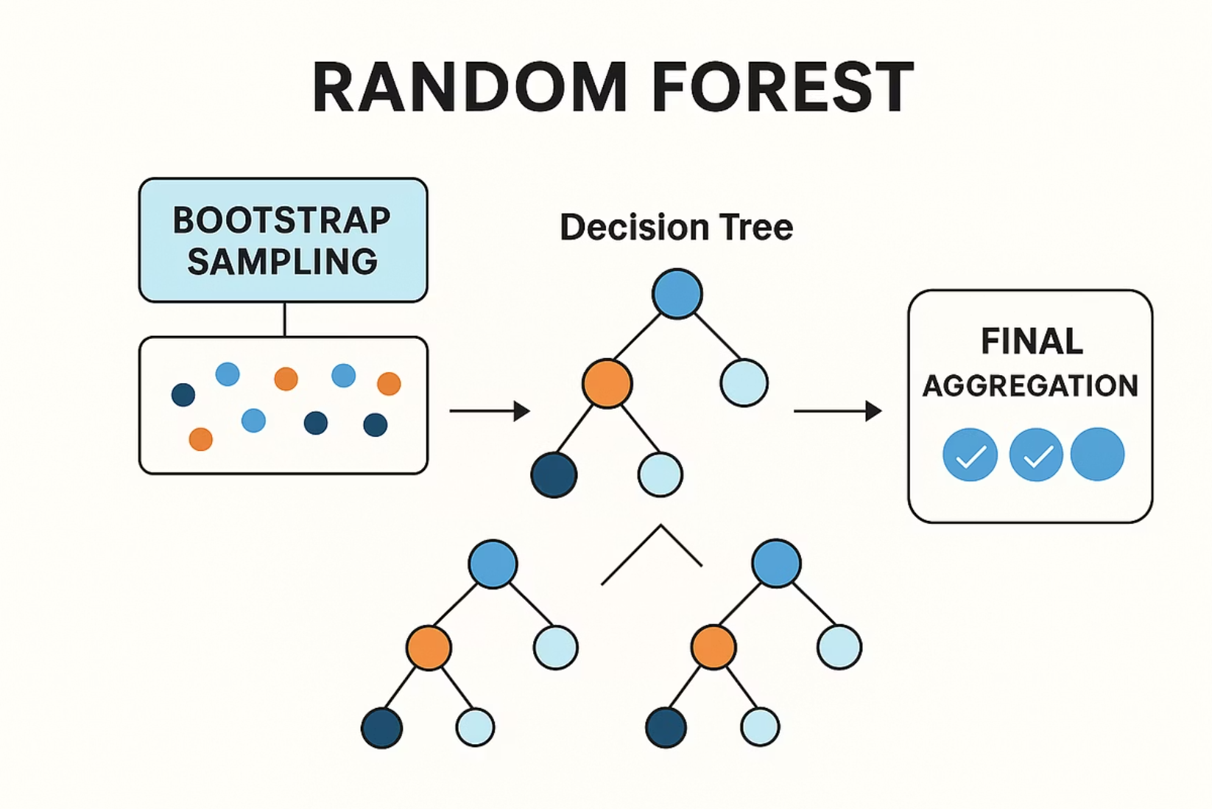
Bootstrap Sampling Explained
How It Works
Bootstrap sampling is a technique that creates new training datasets by randomly selecting rows from the original data with replacement.
Each sample matches the original dataset size
Some rows appear multiple times
Some rows don't appear at all
Every tree gets a unique sample
This simple yet powerful technique ensures each decision tree experiences a slightly different version of reality, reducing overfitting and improving generalization.

Slide 5
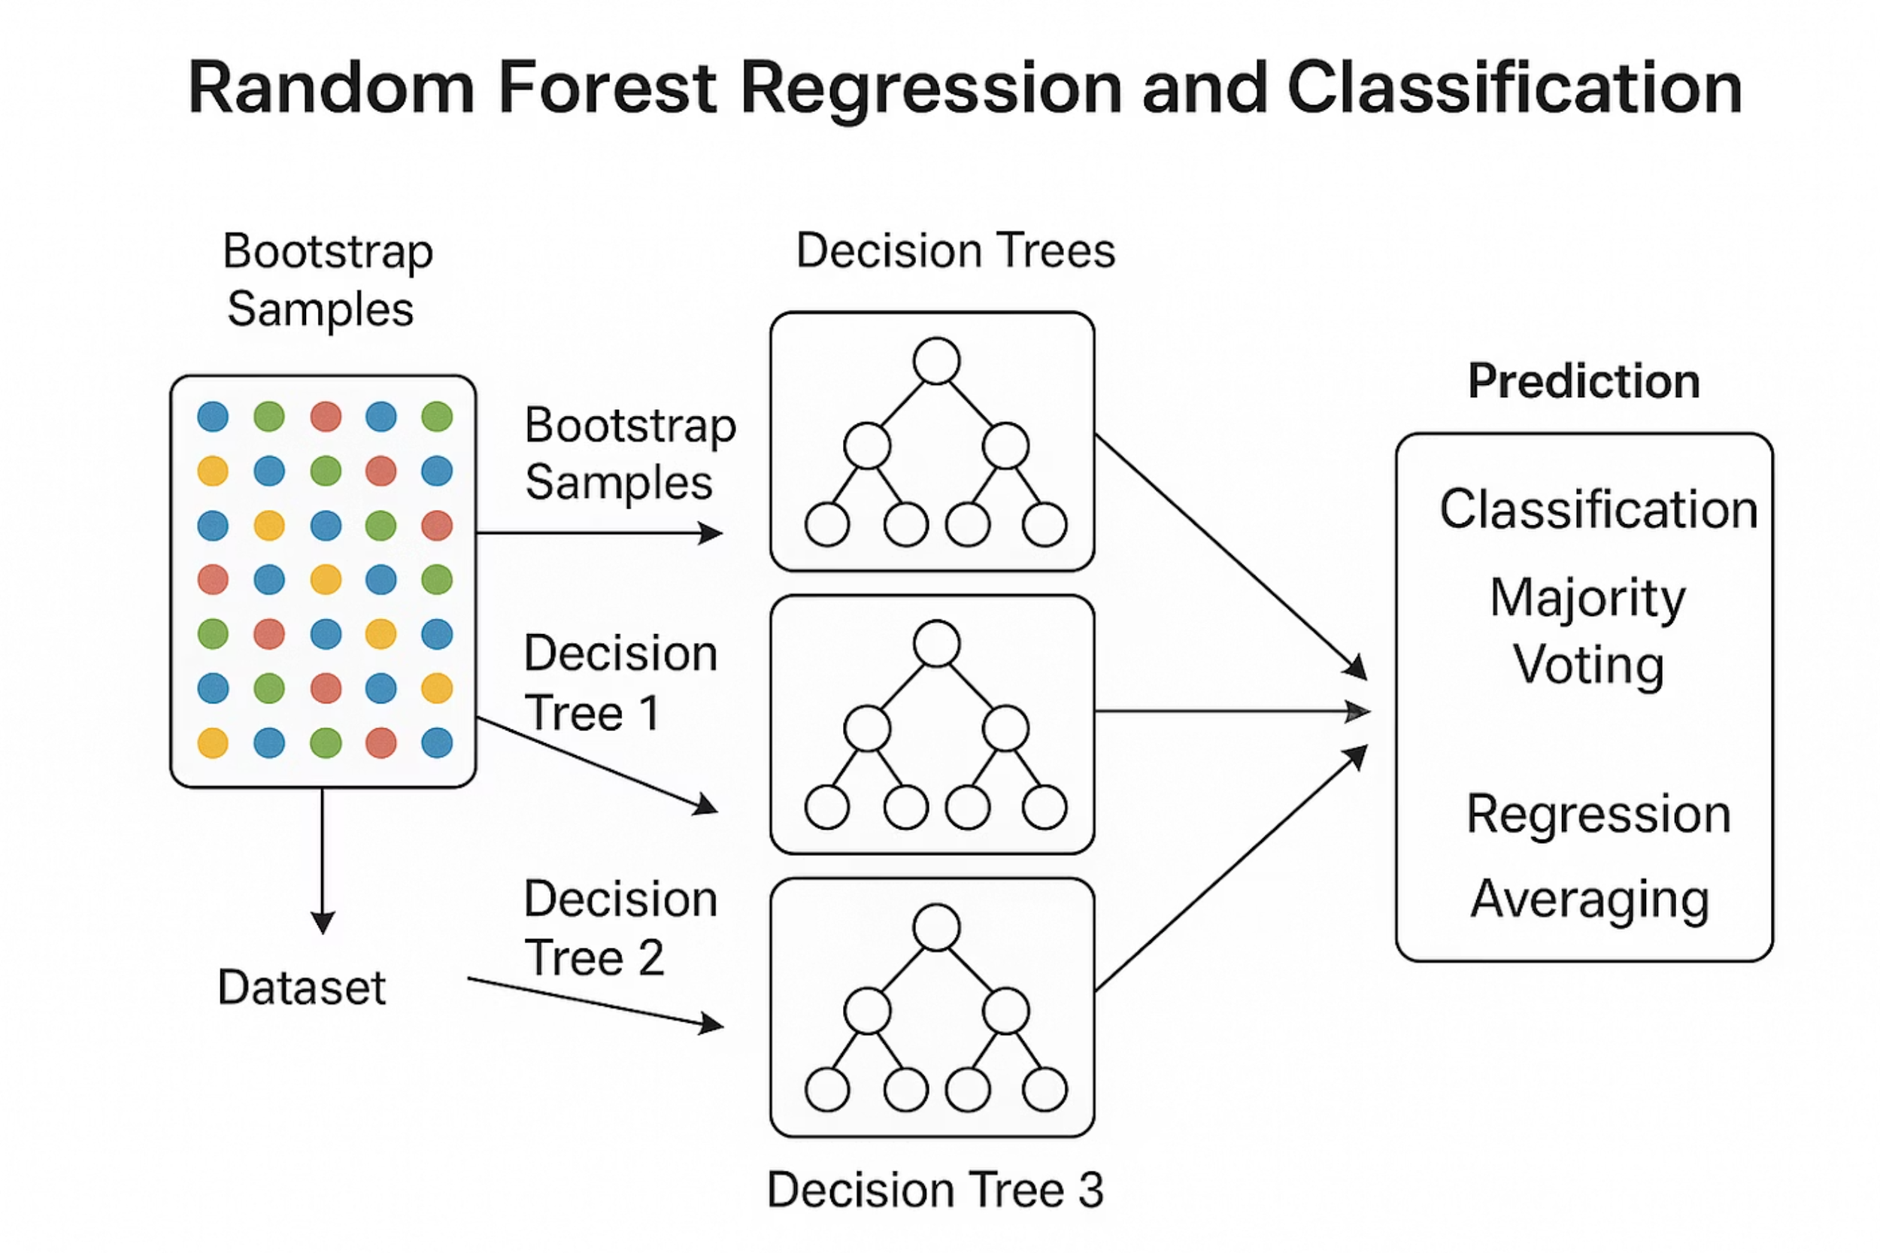


Bootstrap Sampling Example
Original Dataset
Our starting point contains 8 unique data points arranged sequentially:
[1, 2, 3, 4, 5, 6, 7, 8]
Bootstrap Sample
After random sampling with replacement, we get a new dataset of the same size:
[2, 8, 2, 1, 5, 2, 7, 8]
Notice how some values appear multiple times (2 appears three times, 8 appears twice) while others are missing entirely (3, 4, and 6 aren't selected). This variation is exactly what creates diversity!

Slide 6
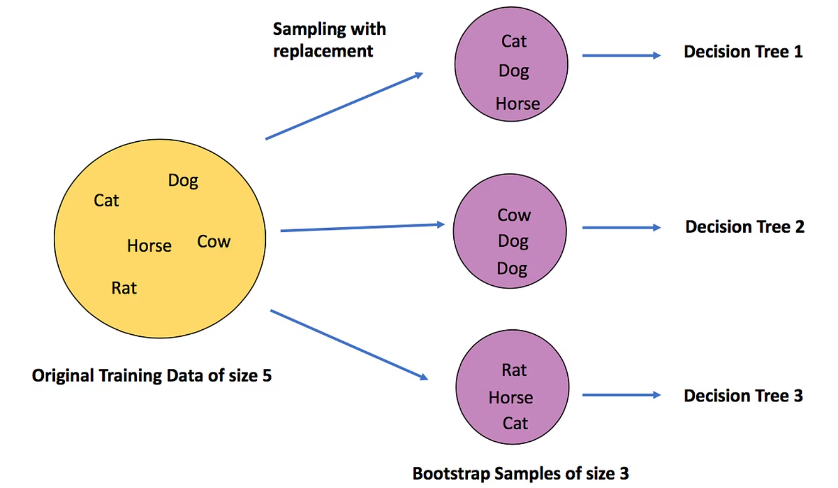
Out-of-Bag Samples
Every bootstrap sample leaves some data behind. These leftover rows are called out-of-bag (OOB) samples, and they serve a valuable purpose:
01
02
03
Not Selected in Bootstrap
Unique for Each Tree
Built-In Validation
Approximately 37% of rows are excluded from each bootstrap sample due to the nature of random sampling with replacement.
Different trees have different OOB samples, since each tree's bootstrap sample is generated independently.
OOB samples act as a free validation set, allowing you to estimate model performance without splitting your data.

Slide 7
Effect of Bootstrap Sampling
Bootstrap sampling transforms the Random Forest from a collection of similar trees into a diverse ensemble with distinct strengths:
Different Data Exposure
Reduced Correlation
Lower Variance
Trees become less correlated with each other, making independent predictions rather than echoing the same patterns.
The ensemble becomes more stable, with reduced sensitivity to small changes in the training data.
Each tree trains on its own unique dataset perspective, learning different patterns and relationships.

Slide 8
Feature Randomness at Each Split
Beyond data sampling, Random Forests add another layer of randomness at every decision point within each tree:
1
Full Feature Set Available
The tree has access to all features in the dataset initially.
2
Random Subset Selected
At each split, only a random subset of features is considered as candidates (typically √n for classification).
3
Best Split Chosen
The optimal split is selected from this limited subset, not from all available features.
This process repeats at every node, ensuring maximum diversity in how trees make decisions.

Slide 9
Feature Randomness Example
Imagine a credit risk model with features: Age, Income, Debt, Credit History, Employment Status
1
2
3
Split 1: Tree A
Split 1: Tree B
Split 1: Tree C
Random subset: Income, Debt
Random subset: Age, Credit History
Random subset: Employment Status, Income
Chosen split: Debt > $50,000
Chosen split: Age < 30
Chosen split: Income > $75,000
Even at the first split, each tree takes a completely different approach to the problem!

Slide 10
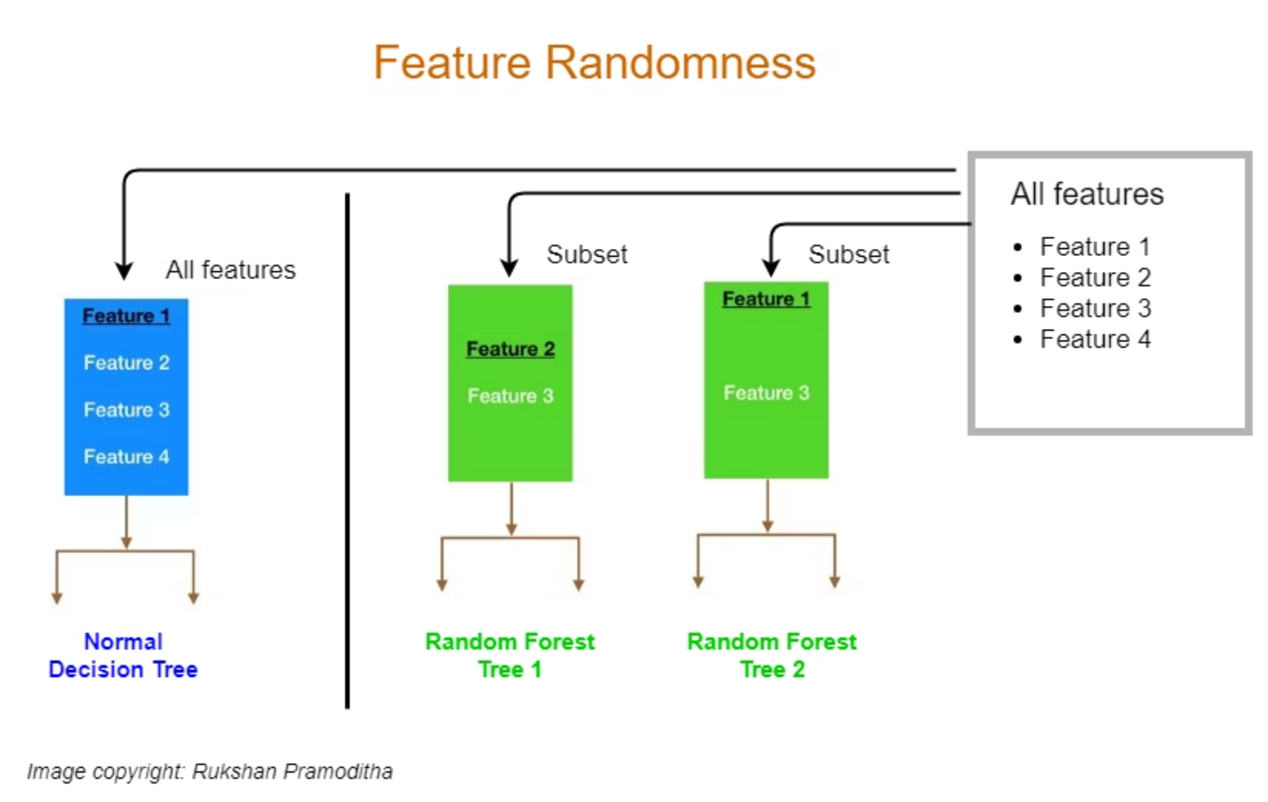
Feature Randomness Visualization
This diagram compares how decision trees select features:
Normal Decision Tree (left): Uses all features at each split, leading to similar tree structures.
Random Forest Trees (center and right): Each tree considers only a random subset of features at each split, creating diverse tree structures that capture different patterns.
This diversity leads to more robust predictions.

Slide 11


Why Feature Randomness Matters
Feature randomness addresses a critical problem in ensemble learning: feature dominance.
Prevents Dominant Features
Forces Diverse Paths
Without randomness, the strongest predictive feature would be selected at the top split of nearly every tree, creating highly correlated trees.
By limiting feature choices, trees must explore alternative decision boundaries, discovering complementary patterns in the data.
The result: an ensemble where each tree contributes unique insights, rather than redundant predictions.

Slide 12








Combined Effect of Randomness
When both sources of randomness work together, something remarkable happens:
Data Randomness
Feature Randomness
Bootstrap sampling gives each tree a unique training dataset
Random feature subsets create diverse decision paths within each tree
Stable Predictions
Diverse Ensemble
The ensemble delivers robust, accurate predictions that generalize well to new data
The result is a collection of truly independent, complementary trees
This elegant combination of randomness is what makes Random Forests one of the most reliable and widely-used machine learning algorithms.

Slide 13

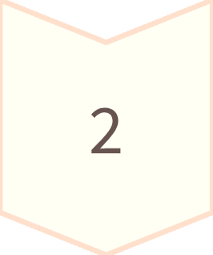
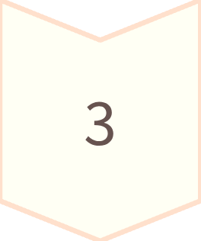

From Bootstrap to Bagging – The Missing Link
Bootstrap sampling creates multiple versions of your dataset through random sampling with replacement. But here's the key question: what happens next? Training a single model on one bootstrap sample doesn't unlock the full potential of this technique.
Bootstrap Samples
Multiple versions of your dataset created through random sampling
Multiple Models
Each sample trains an independent model using the same algorithm
Aggregation
Combine predictions to get robust, stable results
Bagging = Bootstrap + Aggregation – This elegant combination transforms variance into strength by training multiple models and combining their wisdom.

Slide 14
What Is Bagging?
Bagging, short for Bootstrap Aggregating, is an ensemble technique that leverages the power of multiple models working together. Each model trains independently on a bootstrap sample, then their predictions are combined for a final, more reliable output.
01
02
03
Create Bootstrap Samples
Train Models Independently
Aggregate Predictions
Generate multiple random samples with replacement from the original dataset
All models use the same algorithm (like decision trees) but learn from different data
Classification uses majority voting; regression averages the predictions
Classification
Regression
Majority Voting: Each model casts a vote, and the most popular prediction wins
Averaging: Take the mean of all model predictions for a smooth, stable estimate
Goal: Reduce variance and improve model stability by combining diverse perspectives from multiple trained models.

